Slide 1
Field training presentation
Presented by : Latifa Mohmmed Al yaeesh

Slide 2
Content
Introduction
Self-introduction
Company profile
Details of training experience
Title
Introduction
Content
Conclusion
Acquired Skills & Certificates
Appreciation
Q & A

Slide 3
Self-introduction
Personal information:
Student Name: Latifa Mohmmed Alyaeesh
Student ID: 35120039
Major: Management Information Systems
Semester: 401
Company : Imam Abdulrahman bin Fasial University ( College of Science & Humanities )
Academic supervisor: Anwar Al shehri

Slide 4

Company profile
Imam Abdulrahman bin Faisal University
1975
College of Education ( College Of Science & Humanities)
March , 1999
Two departments:
Art departments
Science departments

Slide 5

Details of training experience

Slide 6

Title
Automatic Correction Management System
Introduction
Problem Identification
The capabilities
The benefits

Slide 7
Problem Identification
The capabilities:
Faculty member
Administrator
Department

Slide 8
Problem Identification
The benefits:
Reduce paper usage
Simple and easy to use
Provide valuable feedback
Helps in saving effort and time
The system viewing anytime anywhere

Slide 9
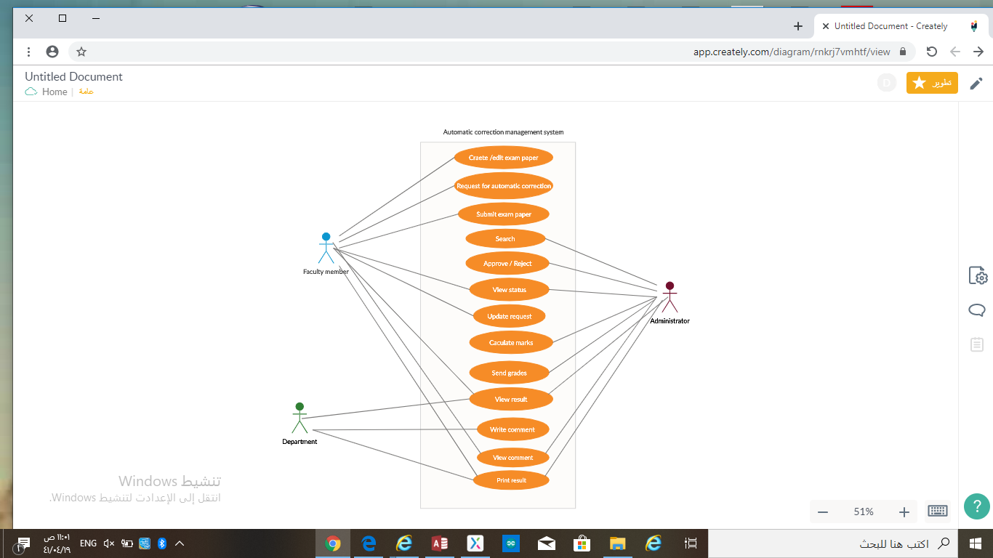
Content – Model used
1- Use Case Diagram(UCD):

Slide 10
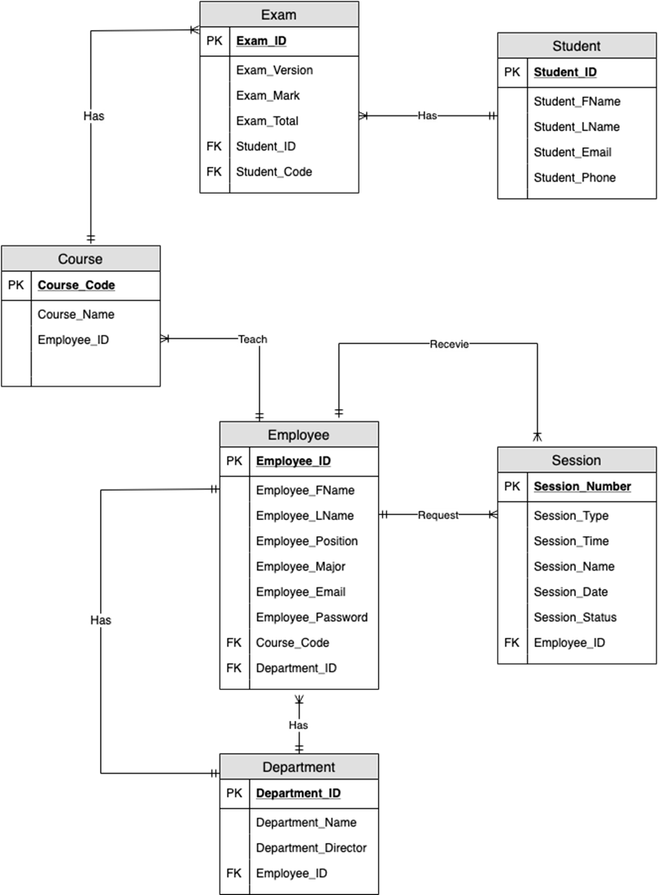
Content – Model used
2- Entity Relationship Diagram(ERD):

Slide 11


Implementation
Tools used to build the system:
Microsoft Access software
Axure prototyping software

Slide 12
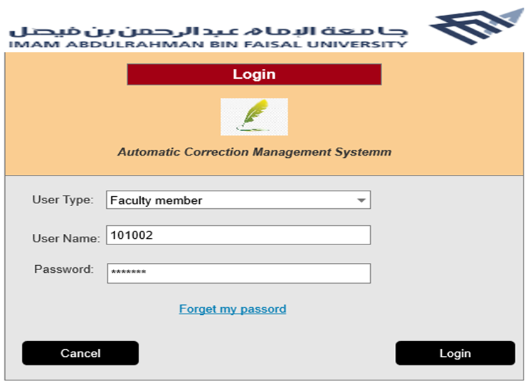
User interface
Login page:

Slide 13
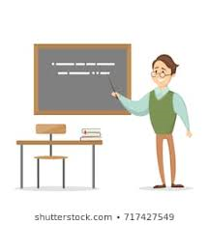
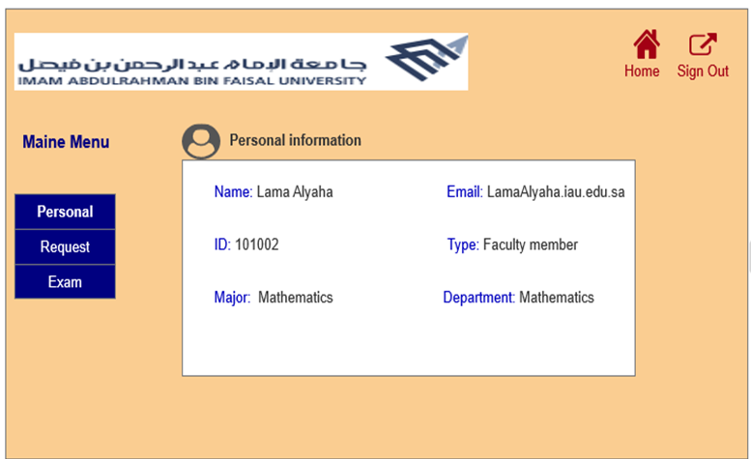
Faculty member page
Home page:

Slide 14
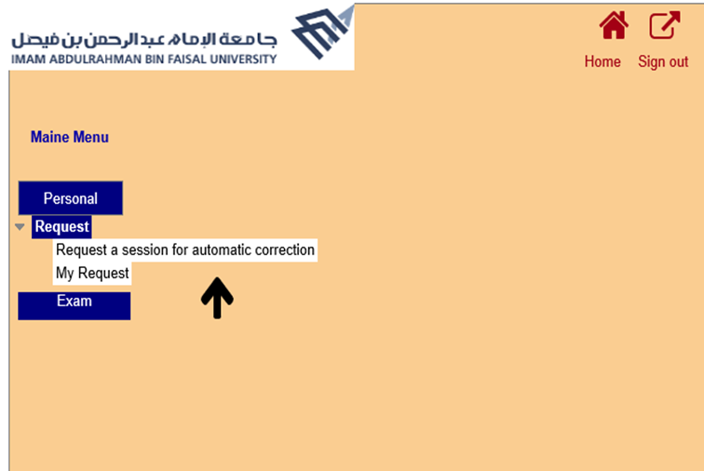
Request “ Session” page:

Slide 15
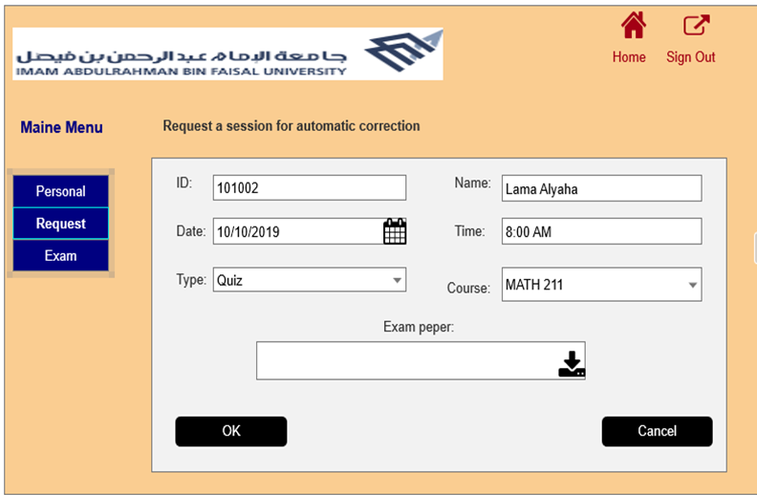
Request a session for automatic correction page:

Slide 16
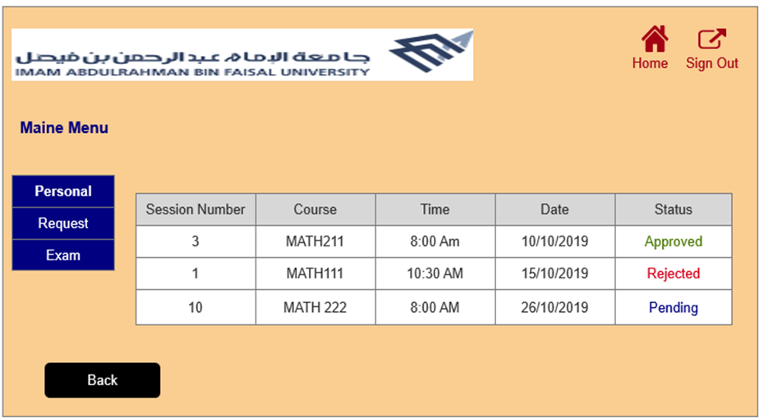
My request page:

Slide 17
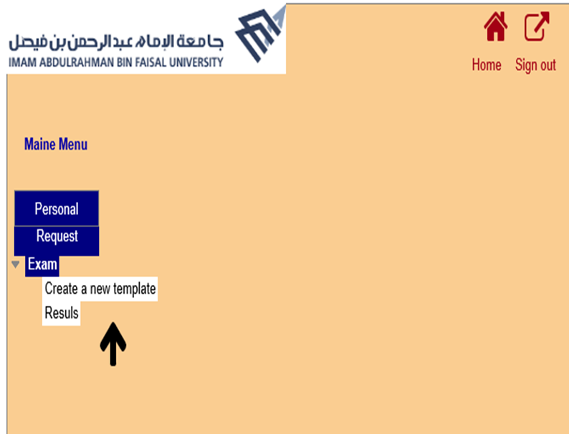
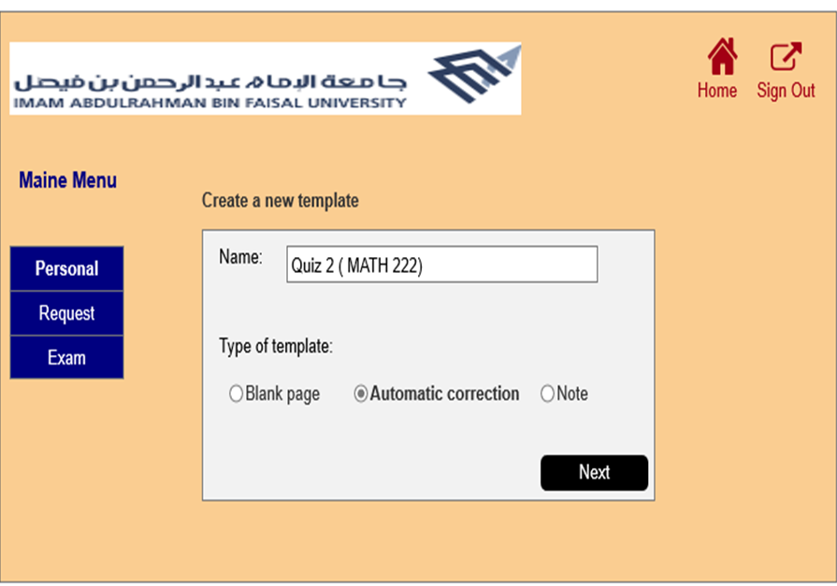
Exam & Create a new template page:

Slide 18
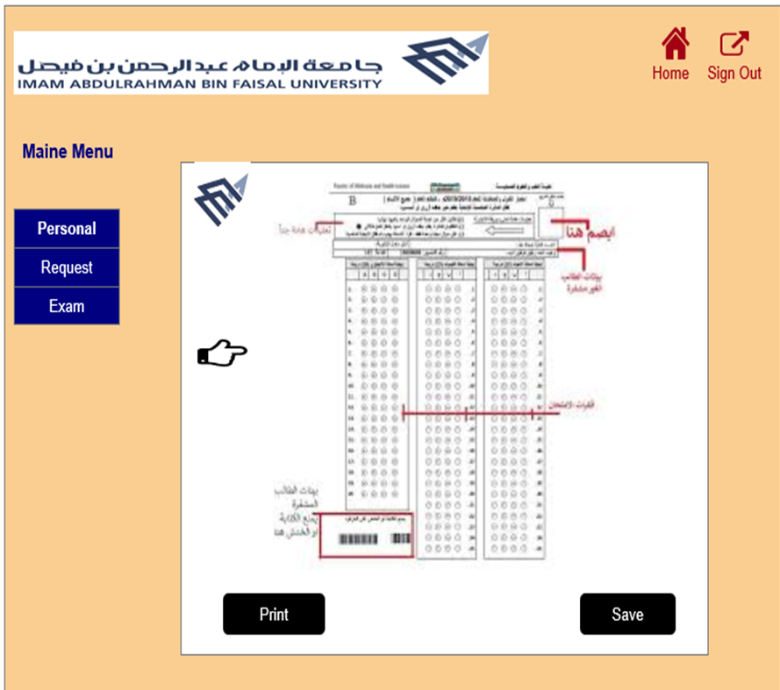
Exam paper page:

Slide 19
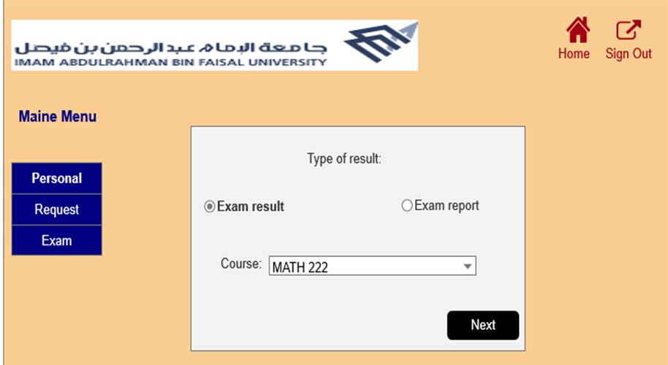
Exam page:

Slide 20
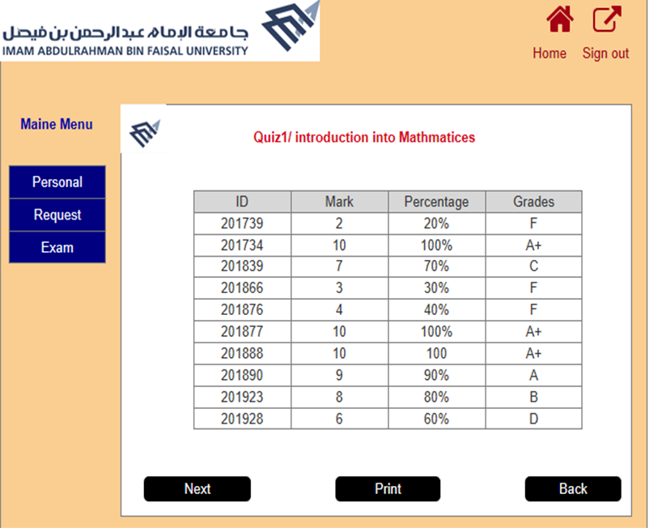
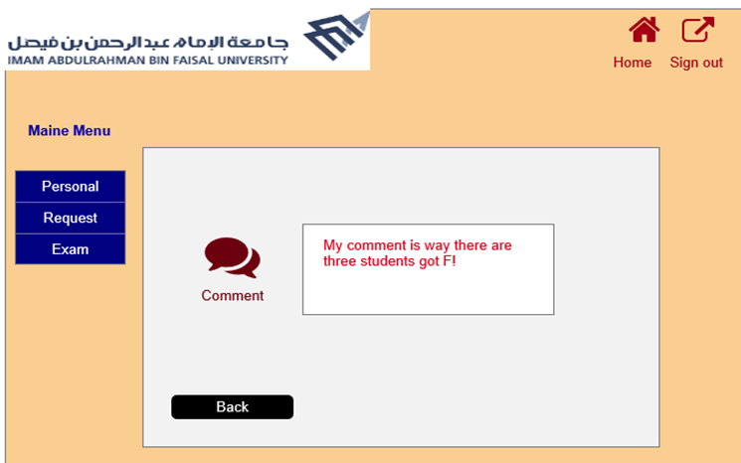
Exam results
&
Comment pages

Slide 21

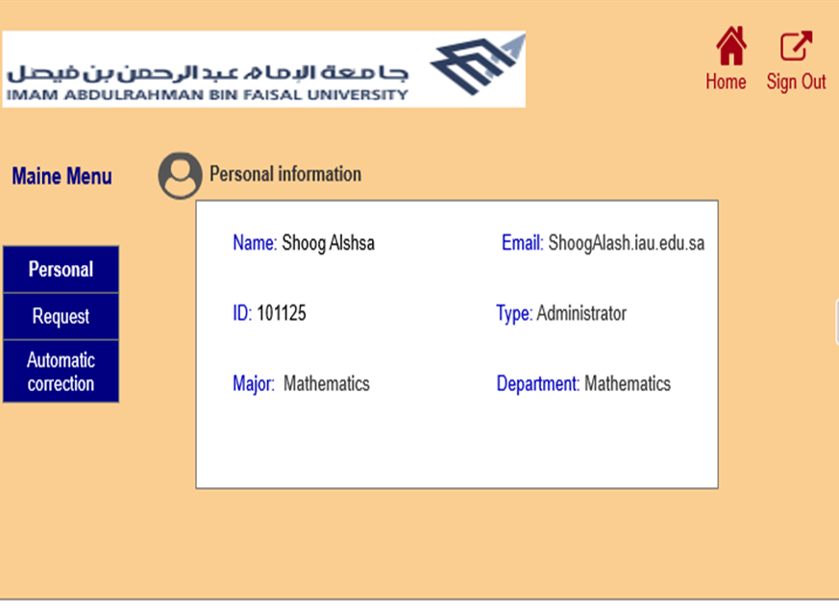
Administrator page
Home page:

Slide 22
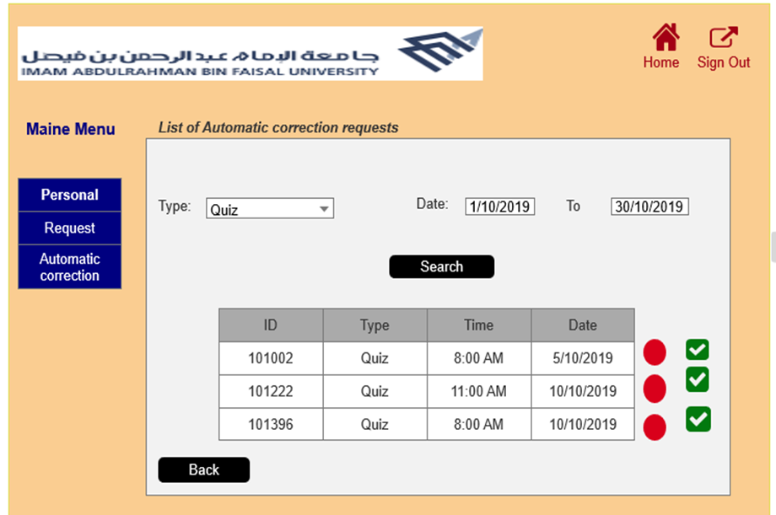
List of Automatic correction requests page

Slide 23
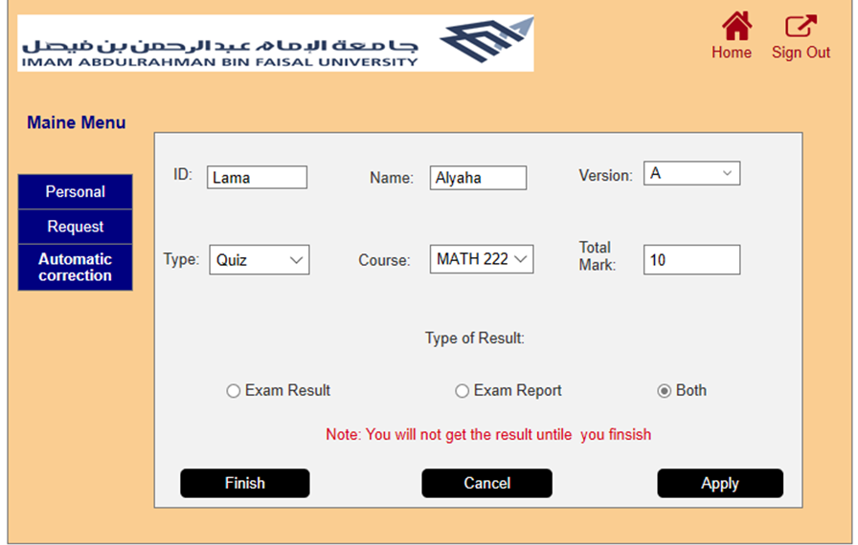
Automatic correction page:

Slide 24
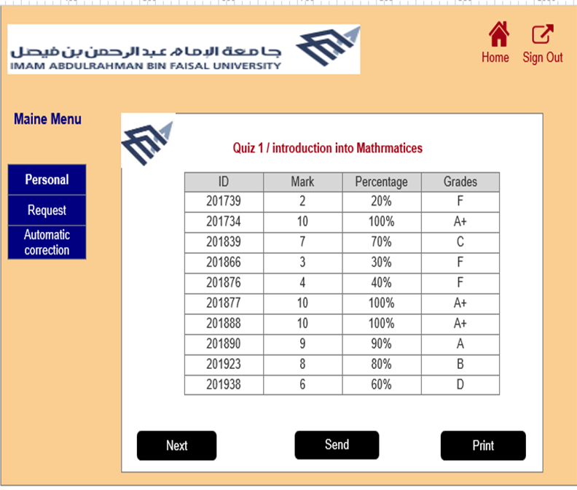
Exam result page:

Slide 25
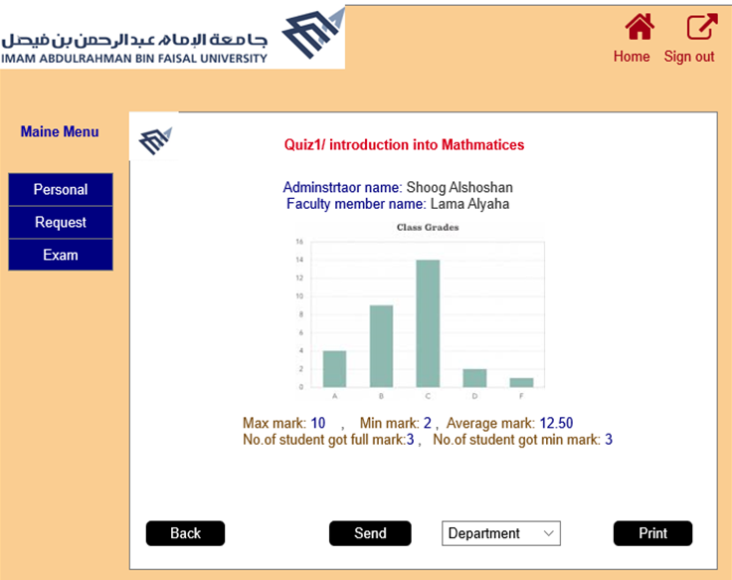
Exam report page:

Slide 26
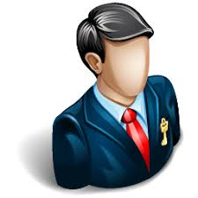
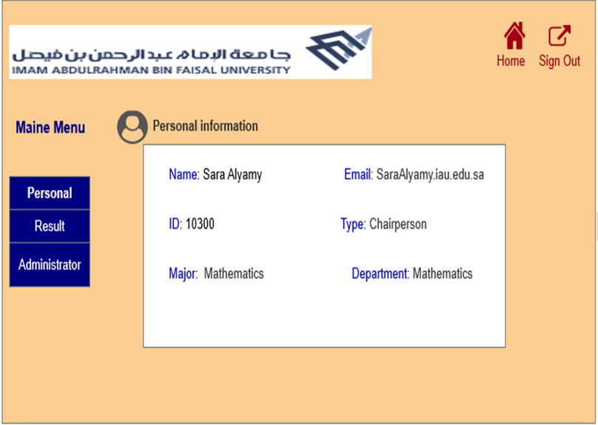
Department page
Home page:

Slide 27
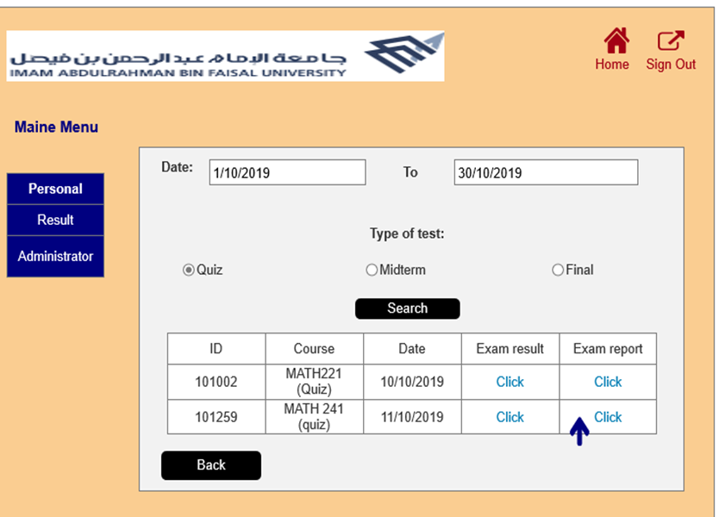
Result page:

Slide 28
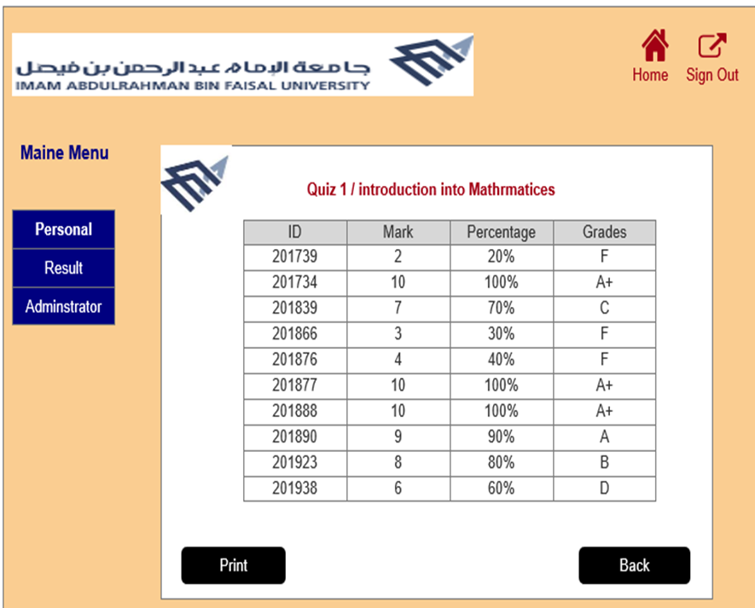
Exam results page:

Slide 29
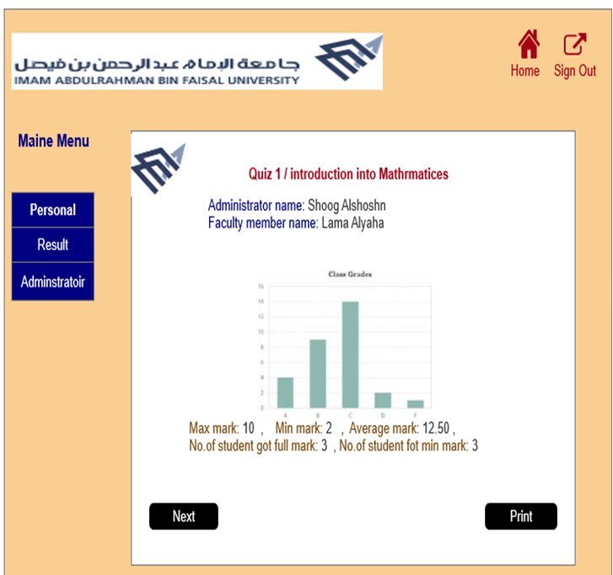
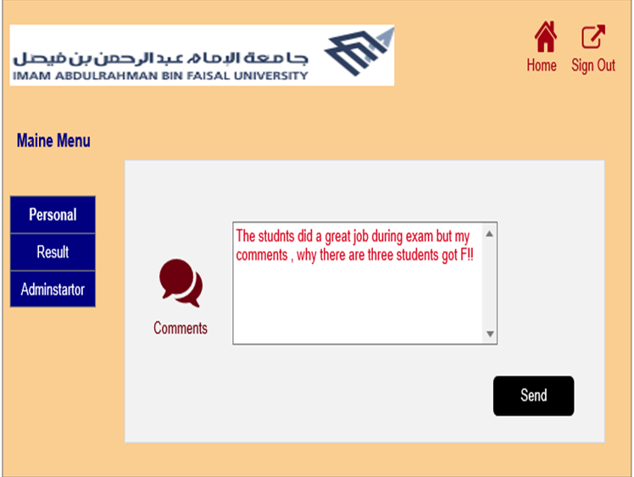
Exam report
&
Comment page

Slide 30
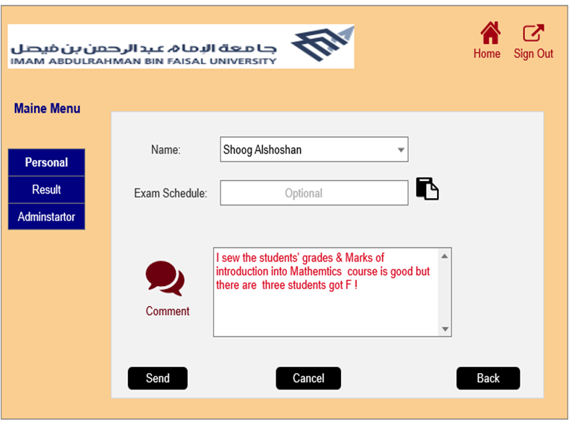
Administrator comment page:

Slide 31
Acquires Skills & Certificates

Slide 32

Acquired Skills
These skills are:
Communication
Willing to learn new tasks
Teamwork
Commuter skills
Interpersonal abilities
Problem solving

Slide 33
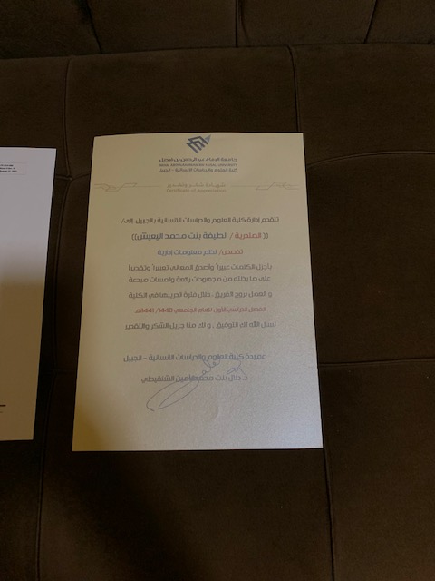
Certificate

Slide 34
Appreciation

Slide 35
Appreciation
Allah
Then:
My family
My friends
Jubail University College
My academic supervisor: Ms. Anwar Al shehrai
Ms. Lama Alruqaie
Imam Abdularhaman bin Faisal University

Slide 36
Q & A

